Slide 1
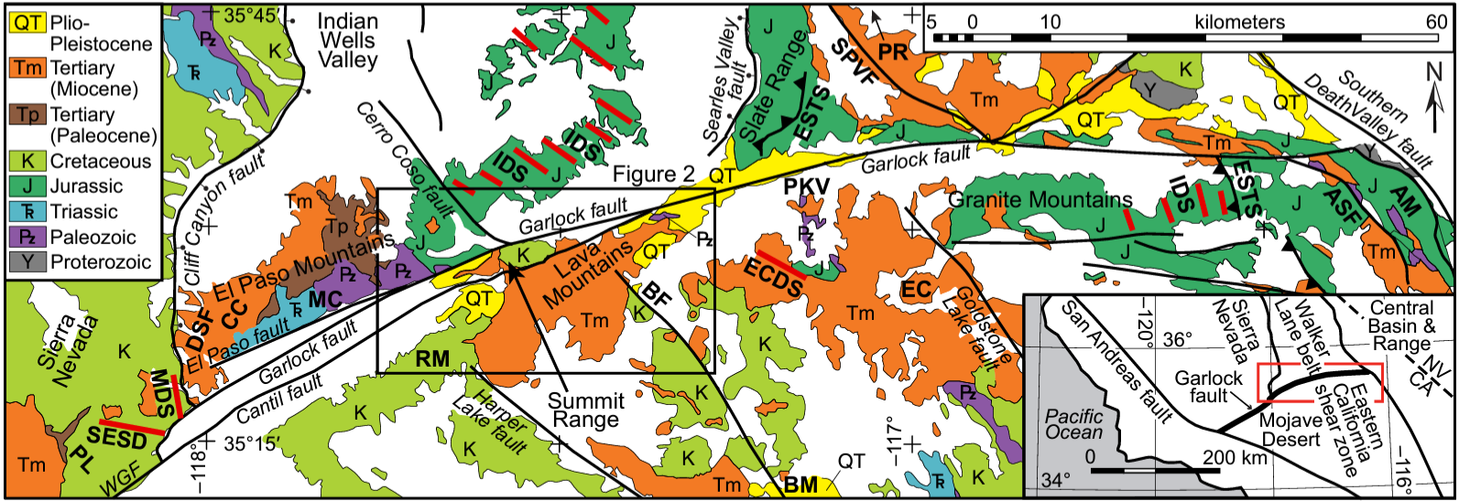
Evolution of the central Garlock fault zone, California: A major sinistral fault embedded in a dextral plate margin
J.E. Andrew, J.D. Walker, and F.C. Monastero (2015)
Past studies constrained L-lateral slip; the youngest features (early Miocene) display ~64 km of total offset.
Slip within study area is lower – why?
Megacrystic dacite: 43.7 km
Early Miocene volcanics: 64 km
IDS: 64 km
ESTS: 52-64 km
Map of previously published sinistral offset constraints along the GF. IDS: Independence Dike Swarm (Jurassic); ESTS: East Sierran Thrust System (Jurassic); CC: Cudahy Camp Fm; EC: Eagle Crag Volcanics; BF—Blackwater fault; WGF—western Garlock fault; BM—Black Mountain; DSF—Dove Spring Formation; ECDS—Eagle Crags dike swarm; MDS—megacrystic dike swarm; and SESD—Southeast Sierra dikes. Modified from Walker et al. (2002).

Slide 2
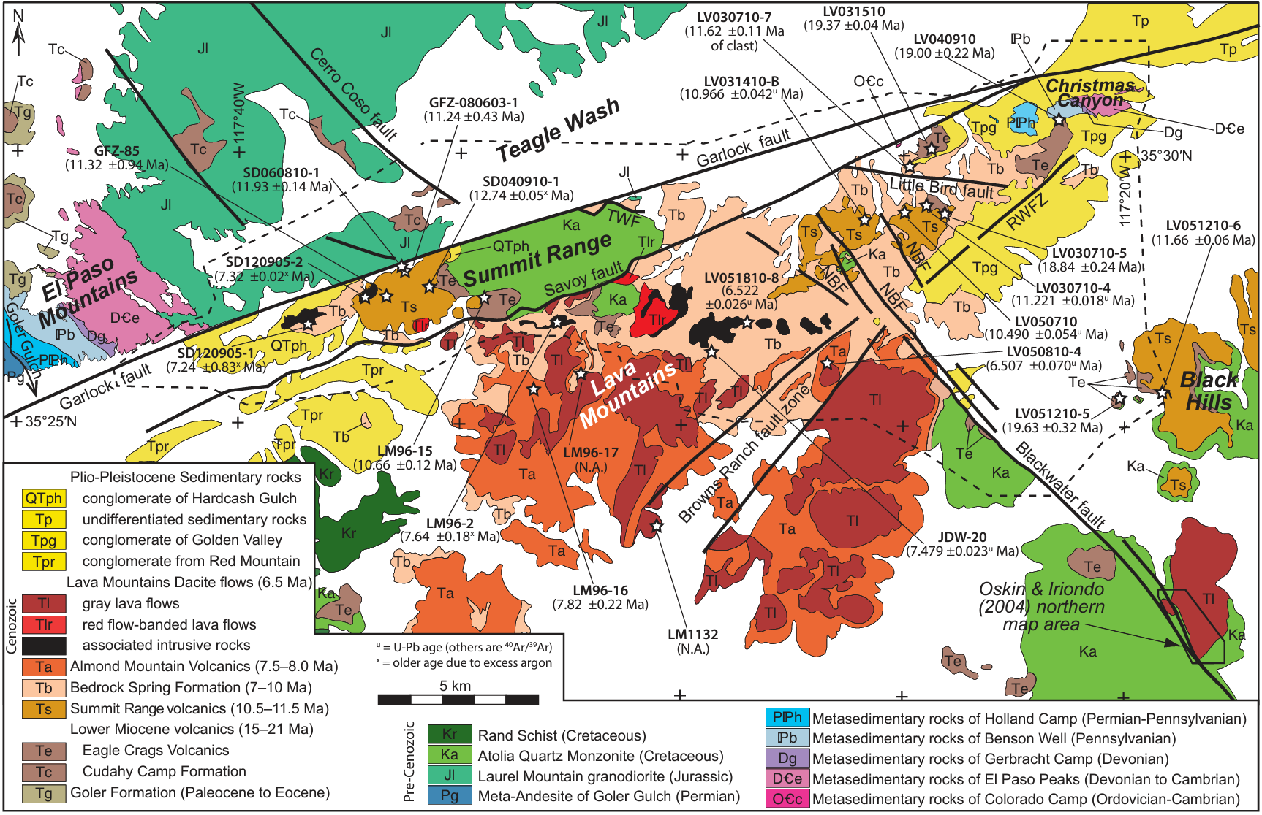
Study Area & Design
GFZ: transversely oriented and opposite sense of shear to San Andreas and Walker Lane belt-ECSZ
Authors focused on a smaller area within the GFZ
Miocene volcanics
Lava Mountains-Summit Range (LMSR)
Mapped and dated younger (Miocene to post-Miocene) rocks to constrain the slip from ~12 Ma to present
⁴⁰Ar/³⁹Ar and U-Pb zircon geochronology
Why?
Previous studies showed LMSR was deformed, but didn’t quantify or determine kinematics of fault slip
Framework to establish relationship between dextral ECSZ and sinistral GFZ
Stratigraphy coupled with 15 fault slip markers and shear sense indicators defines 3-stage history for central GFZ
From Andrew et al. (2015): Geochronologic sample locations are denoted by stars with sample name and interpreted age in parentheses. Faults are thick lines. Fault abbreviations: NBF—northern Blackwater fault; RWFZ—Randsburg Wash fault zone; TWF—Teagle Wash fault. Younger Pleistocene and Holocene units are shown as white.
Notes:
To determine slip direction and sense of shear, authors combined measurements of fault striations with 2 or more shear sense indicators → Riedel shears, fault gouge foliation, drag folds, clast rotation, slickensides, small scale offsets
General movement in LMSR is dominantly strike-slip (aside from Randsburg Wash Fault Zone)
Only slip rates for Garlock fault are discussed

Slide 3
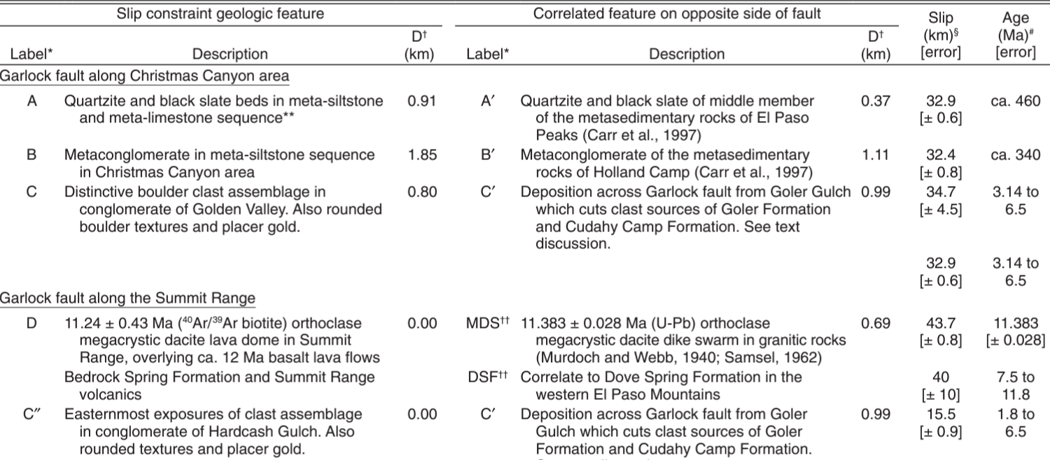
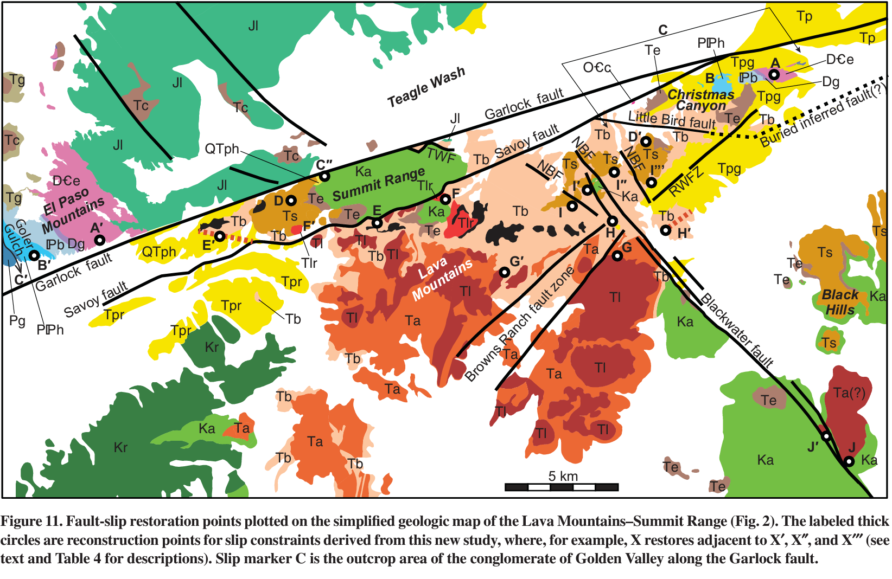
Fault Slip Timing Constraints
Age: ~460 Ma
Slip: ~ 33 km
Age: ~11 Ma
Slip: ~17 km
Age: ~3 – 6.5 Ma
Slip: ~35 km
30-39 km offset of Golden Valley conglomerate (C-C’) aligns with ~33 km offset of Paleozoic marker beds (A-A’)
Implies slip in this area initiated after conglomerate deposition ca. 6.5-3.14 Ma
Savoy fault cuts all Miocene and Pliocene units
Dacite lava flows (ca. 11.2 Ma; D-D’) displaced ~17 km
Younger tuff (ca. 7.5 Ma; E-E’) displaced ~6 km and lava flow (ca. 6.5 Ma; F-F’) displaced ~7.3 km
Can therefore separate into separate slip intervals:
10.7 km between 11.2 and 7 Ma
~6 km between 7 Ma and present
BF at 3.8 Ma initiated multi-strand zone
3 stages of slip were constrained from 11 Ma to present

Slide 4
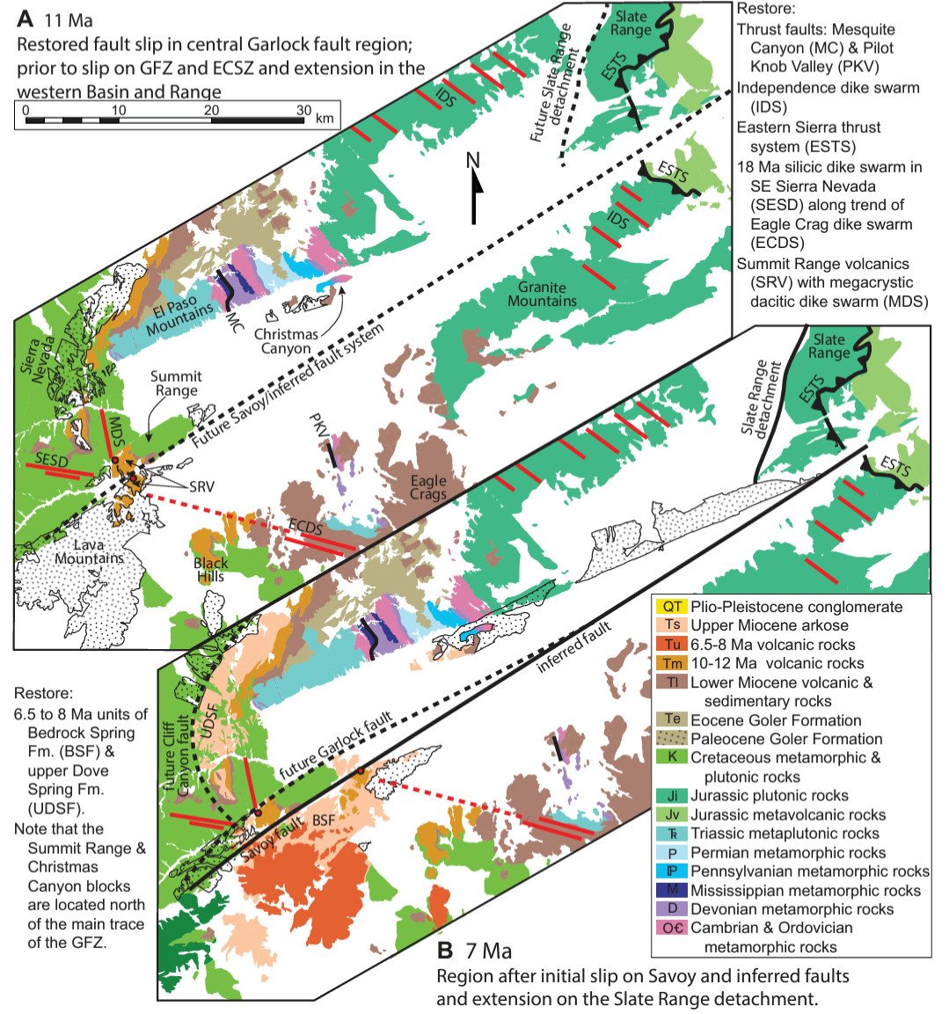
Stage 1: 11-7 Ma
Thick black lines = faults active before time slice
Dashed black lines = faults active after time slice
Initial slip of 10.7 km on Savoy fault ca. ~10.5 to 7 Ma
Slip rate: 3.1 mm/yr
(Authors assume fault was single strand, similar to modern western GF which is outside zone of dextral shear)

Slide 5
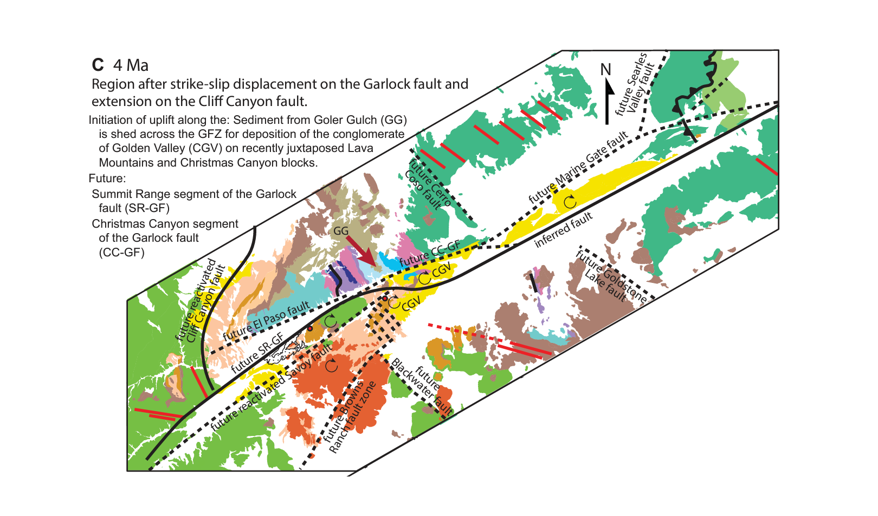
Stage 2: 7 – 3.8 Ma
Slip shifted from Savoy fault to Summit Range segment
Maximum sinistral slip of 19.1 km
Max slip rate: 6 mm/yr
Ca. 4-0 Ma: regional clockwise oroclinal bending occurred due to ECSZ dextral shearing
Constrictional bend created NNW trending folds, and was then abandoned in Stage 3

Slide 6
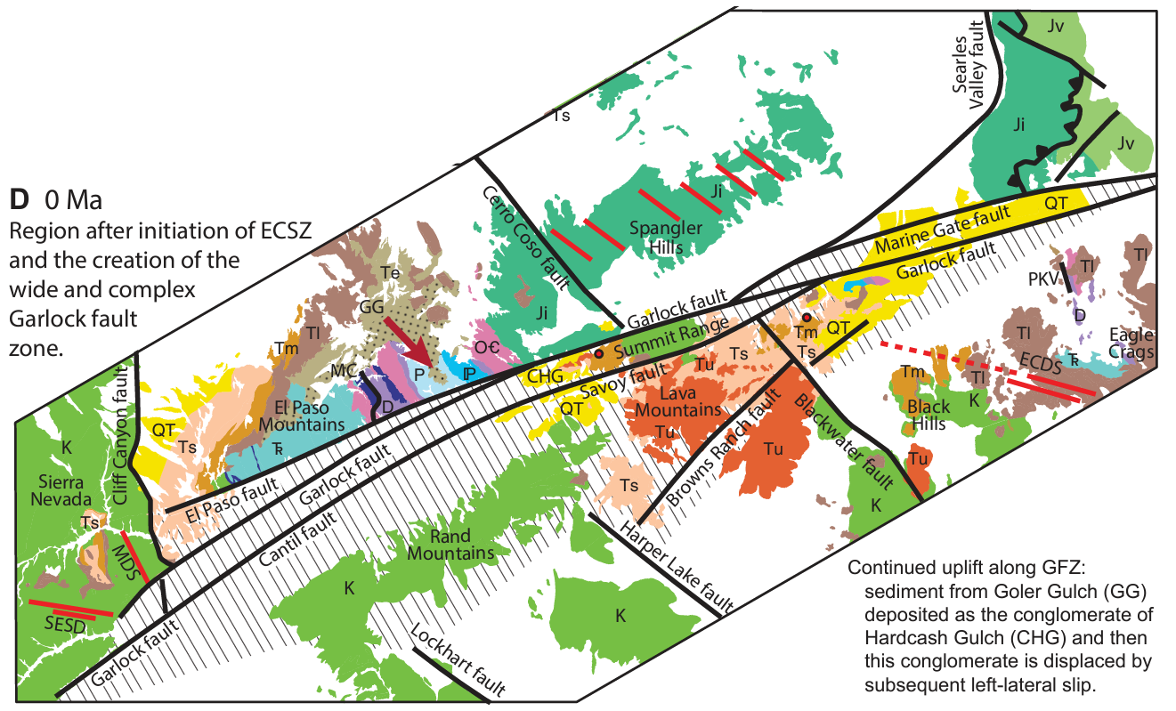
Stage 3: 3.8 – 0 Ma
Diagonal hatching = active GFZ
Age constraints on Blackwater fault suggest Dextral shear initiated <3.8 Ma
BWF doesn’t cut GFZ – must be accommodated somehow
Shortening on western side accommodated by WSW-trending folds, lateral fault sliver escape in summit range area
Lengthening on eastern side accommodated by normal slip on Randsburg Wash fault?
Wide, multi-fault structure formed in response to dextral slip of BWF and clockwise rotation of fault trace
Slip of ~32.9 km
Slip rate: 8.7 mm/yr
Notes:
Dextral shear initiation migrated westward from Death Valley towards IWV

Slide 7
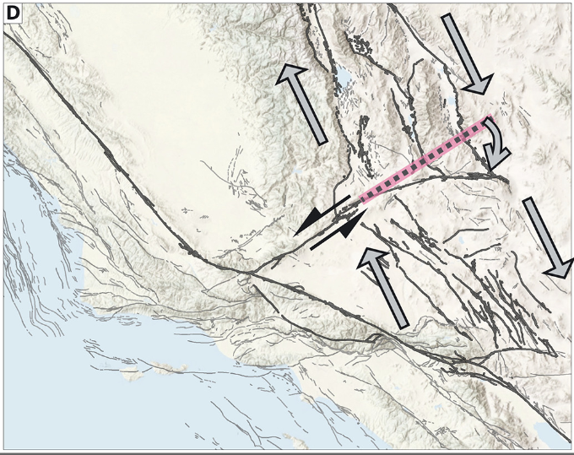
Key Takeaways
Three stages of slip for the central Garlock fault system:
11-7 Ma – GFZ began as a single-stranded sinistral fault
7-3.8 Ma – Summit Range became active strand of GFZ as sinistral system stepped rightward
3.8-0 Ma – Left step; zone became multi-stranded (~12 km wide) to accommodate strain from regional clockwise rotation of GFZ and dextral offset of Blackwater fault during initiation of major ECSZ dextral shear
Distribution of slip is reason for smaller offset compared to total GF offset of ~64 km
Slip rate is 6 – 9 mm/yr for the youngest stage, slower for older stages – aligns with neotectonic rates
LMSR internally accommodates NNW dextral slip associated with ECSZ and Walker Lane
Via clockwise rotation, folding, normal faulting, and new fault creation
Reason BWF doesn’t cross Garlock fault zone
~30 km cumulative slip
~33 km slip from 3.8 – 0 Ma
Hatem & Dolan, 2018: Oroclinal bending model driven by ECSZ dextral shear across Garlock fault. Arrows show inferred clockwise rotation associated with NNW trending dextral ECSZ shear.

